Slide 1

Identifying the Best Neighborhoods to Move to in Chicago
Applied Data Science Capstone Project

Slide 2

tHERE ARE SEVERAL THINGS TO CONSIDER WHEN FINDING A NEIGHBORHOOD TO MOVE TO:
Crime rates
House prices
Proximity to work
Proximity to other venues of interest
For a particular family, interests are:
School rankings
Proximity to parks, martial arts schools, and music schools
We gather the most recent data in all these categories and determine the best neighborhoods (community areas) this family can move to in Chicago.

Slide 3
Data collection and cleaning
1. Geographic boundaries of Chicago community areas ( Chicago Data Portal )
2. Wikipedia data on population and population density of community areas
3. Wikipedia data for community area - neighborhood relation
4. Latitude and longitude information for community areas ( Geopy geocoder library)
5. Crime Data ( Chicago Data Portal – SODA API)
6. Zillow Housing Data ( ZILLOW – research data)
7. School Ranking Data (Chicago Data Portal)
8. Venue data (Foursquare API)
9. Driving distance to Downtown Chicago (Microsoft Bing Maps Distance Matrix API)

Slide 4
Data collection and cleaning
Group crime data (all incidents reported since the beginning of 2019 till 11/27/2020) by community areas
Huge data set -> use SODA API with an SQL-like query to extract relevant data only
Estimate community area median house price s using Zillow single value house price estimates for neighborhoods
Chicago neighborhoods are not official, thus different sources list different number of neighborhoods
Community area – neighborhood relation available in Wikipedia
Wikipedia neighborhoods (246) do not exactly match Zillow neighborhoods (200)
Estimate community area median school scores
School data has ranking and latitude longitude information, no association with community areas
Write a function that determines whether a latitude-longitude pair belongs to a community area using the geojson geometry file
Convert categorical school rankings to numerical scores

Slide 5
Data collection and cleaning
Number of venues of interest within each community area
Determine venue category ids for parks, martial arts schools, music schools
Use Foursquare API with the search endpoint.
Driving distance to Downtown Chicago (job location)
Create a developer account for Microsoft Bing Maps Distance Matrix API
Provide latitudes-longitudes of community areas as origins
Provide latitude-longitude of Downtown Chicago as the destination
Set Travelmode to Driving in the url

Slide 6
Methodology
Explatory Data Analysis
Folium Choropleth maps for each feature
Histograms
Kmeans Clustering

Slide 7
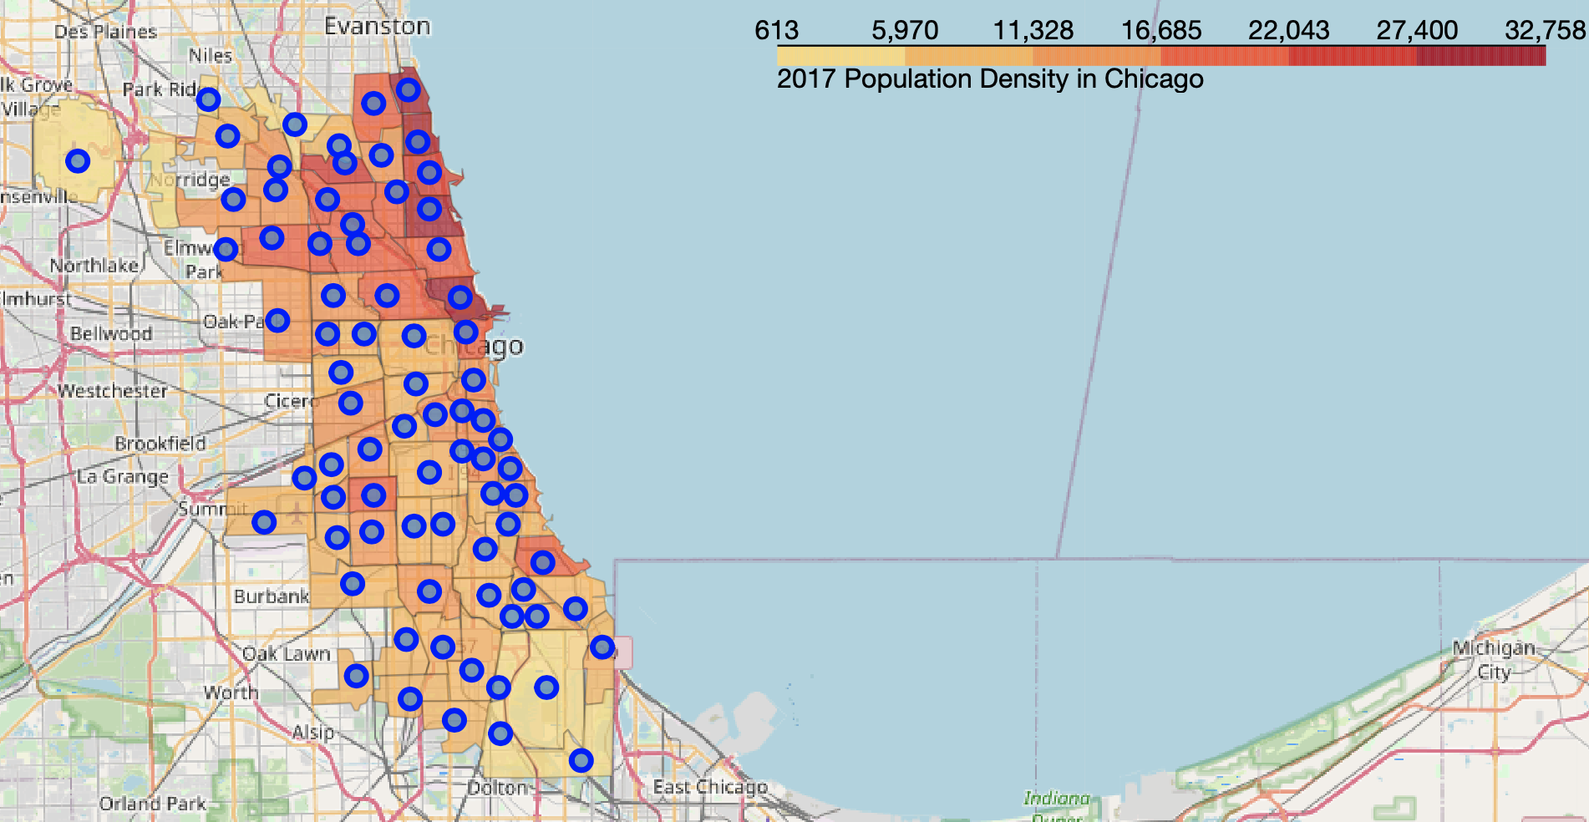
Northeast Chicago has the highest population density

Slide 8
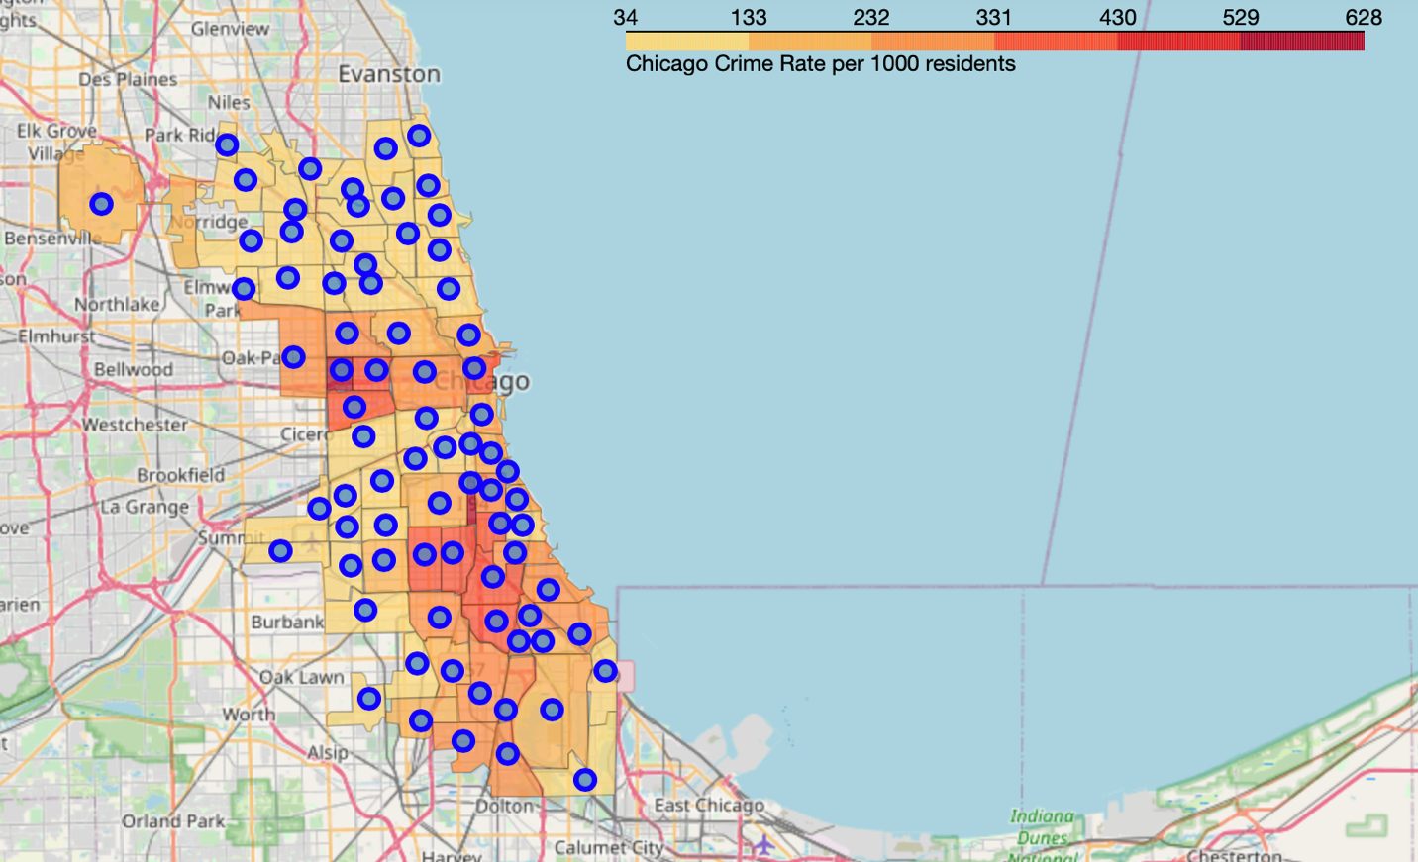
total since the beginning of 2019
CRIME RATES:
Safest: Northern Chicago and Southwest Chicago
Community areas with highest crime rates:
West Garfield Park, Fuller Park,
Garfield Park, North Lawndale,
Englewood, West Englewood,
Greater Grand Crossing and Chatham.

Slide 9
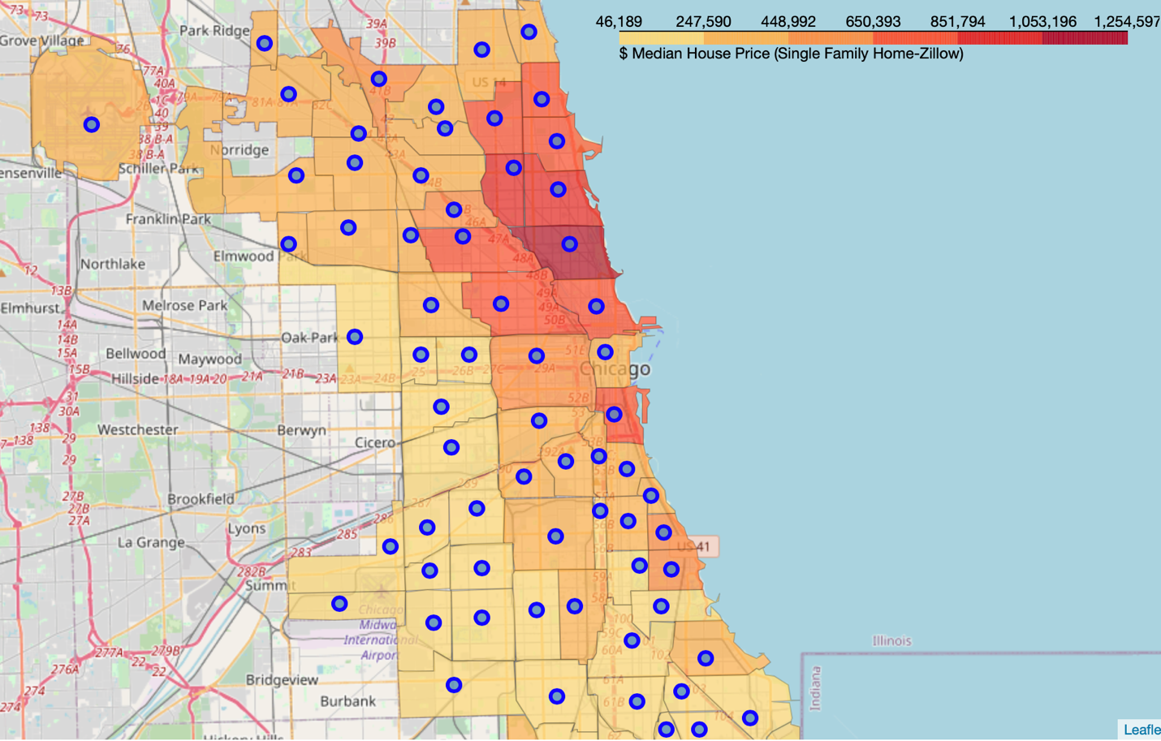
MEDIAN HOUSE PRICES:
Highest in Northeast Chicago
Lowest in West and South

Slide 10
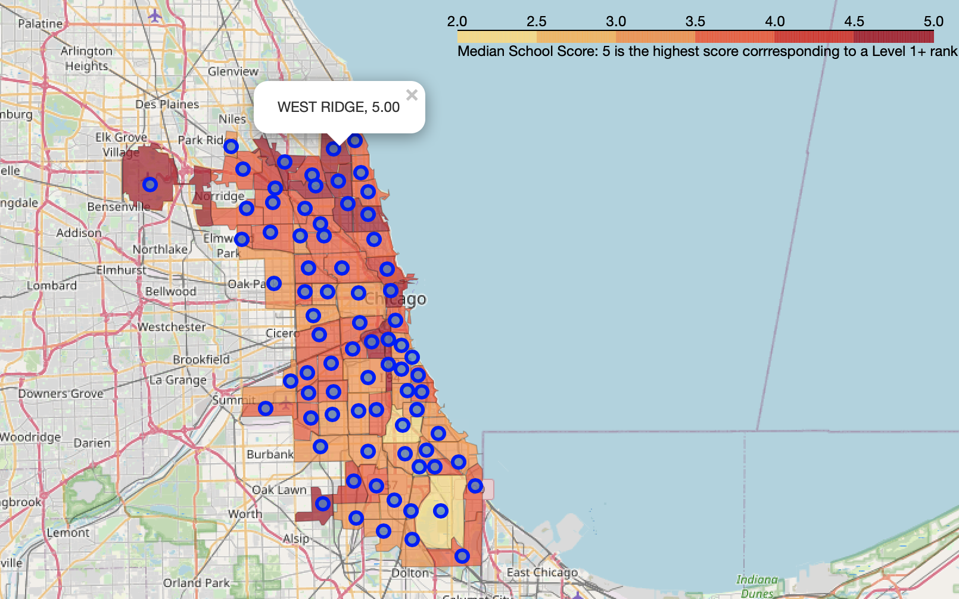
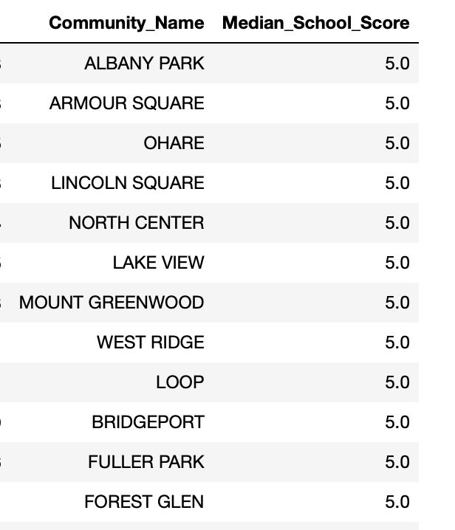
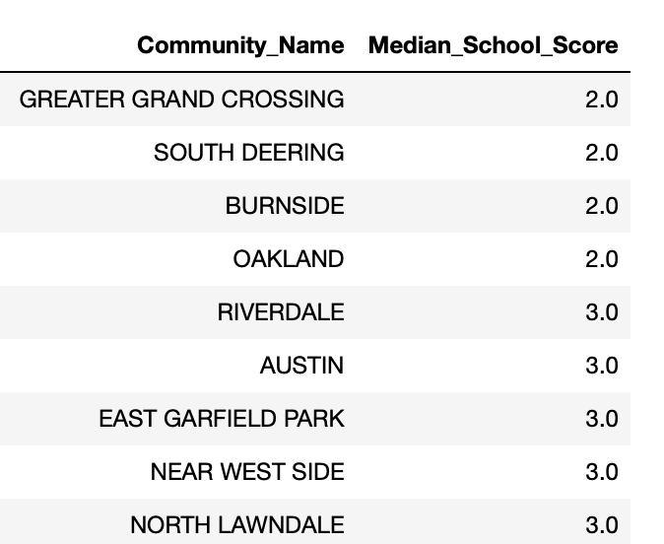
MEDIAN SCHOOL SCORES:
Highest: Northern Chicago and South West Chicago
Lowest and highest ranked community areas:

Slide 11
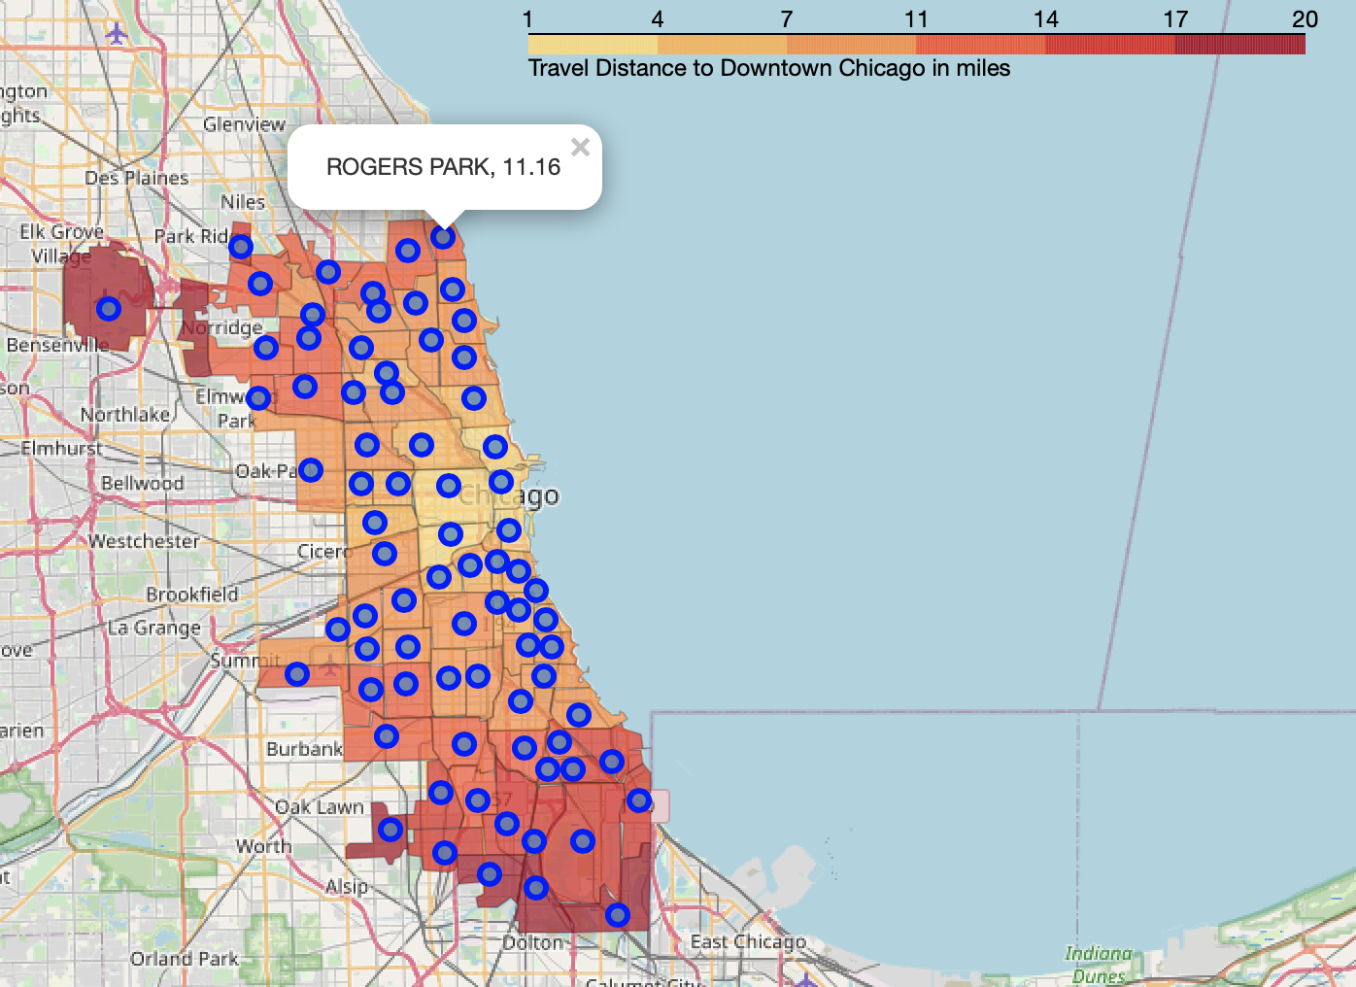
DRIVING DISTANCE TO DOWNTOWN:
Distribution as expected
Nice to click on the marker and see the distance

Slide 12
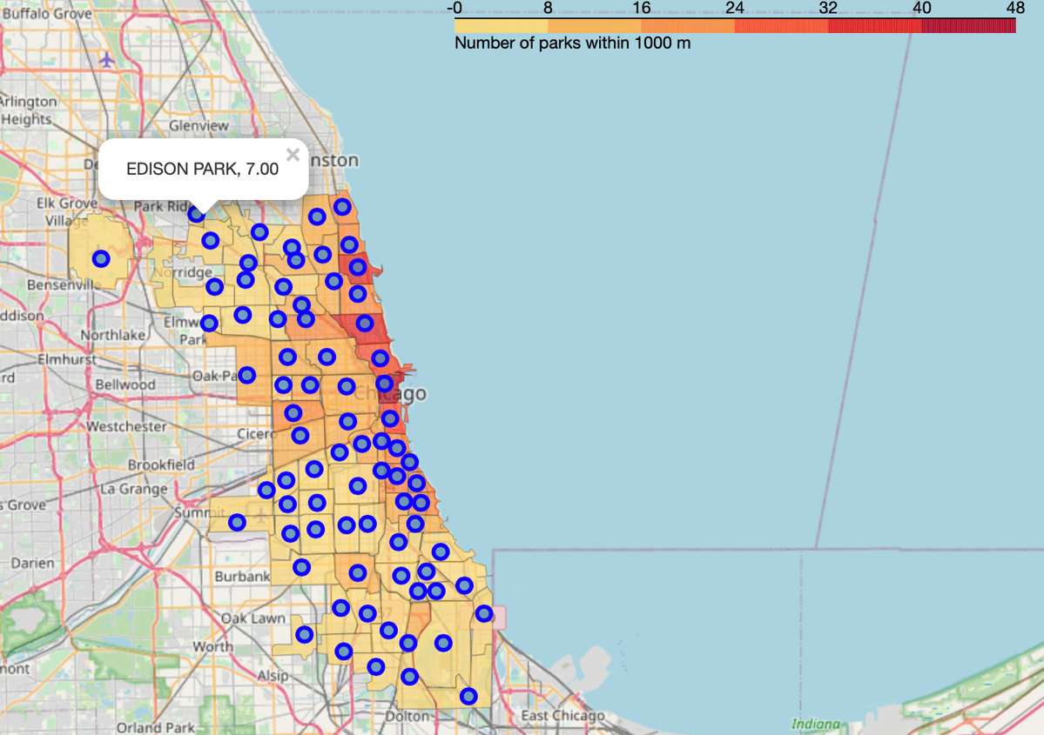
Densely populated areas have more ‘parks’
- Foursquare API considers a wide range of venues under the park category including botanical gardens, monuments, etc.

Slide 13
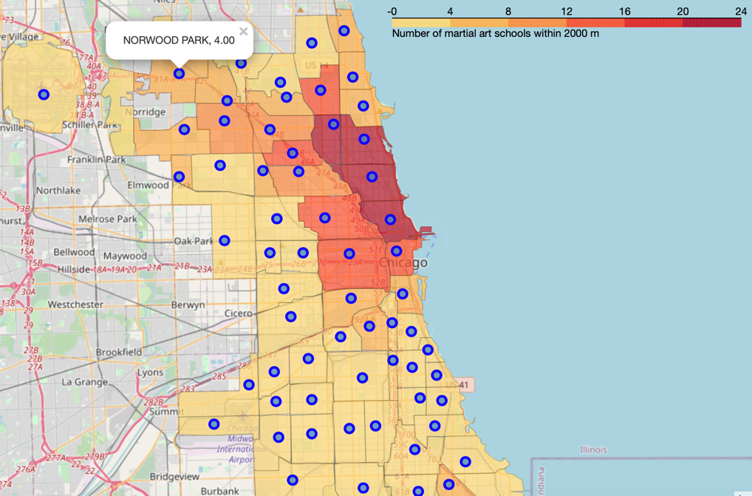
MARTIAL ARTS SCHOOLS:
Northern side has more martial arts schools (denser population)
Similar pattern for music schools
There are more martial arts schools in Chicago compared to music schools.

Slide 14
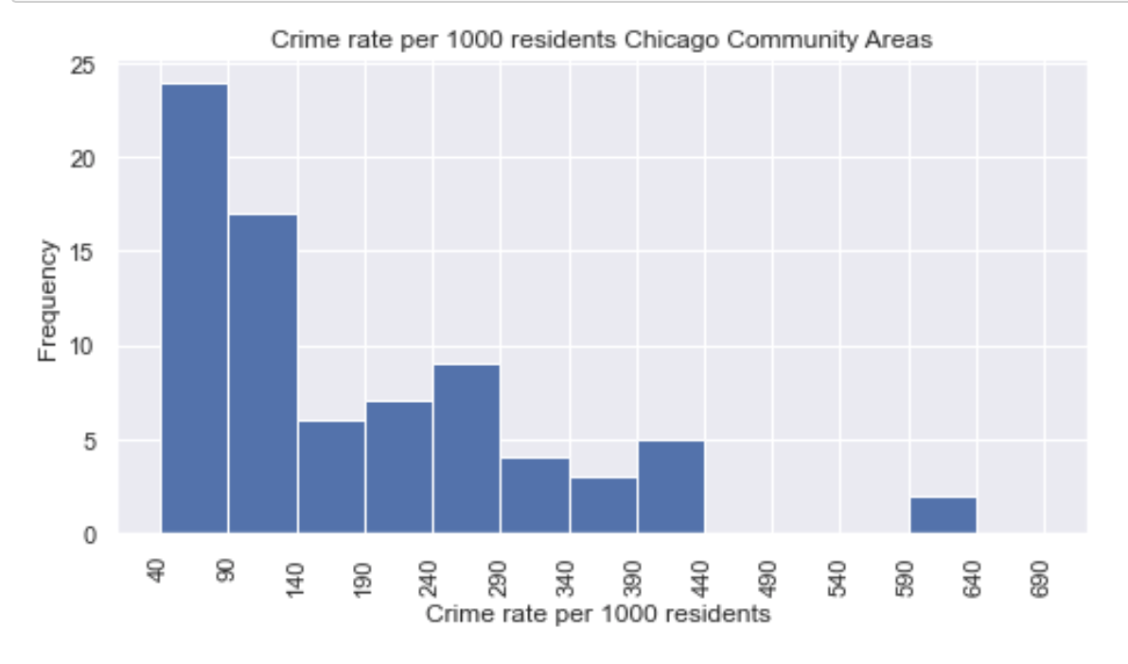
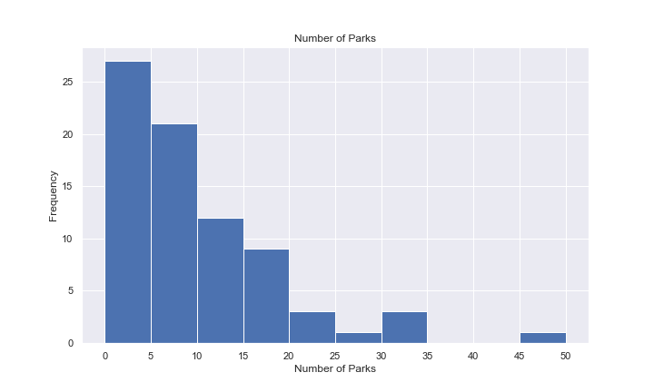
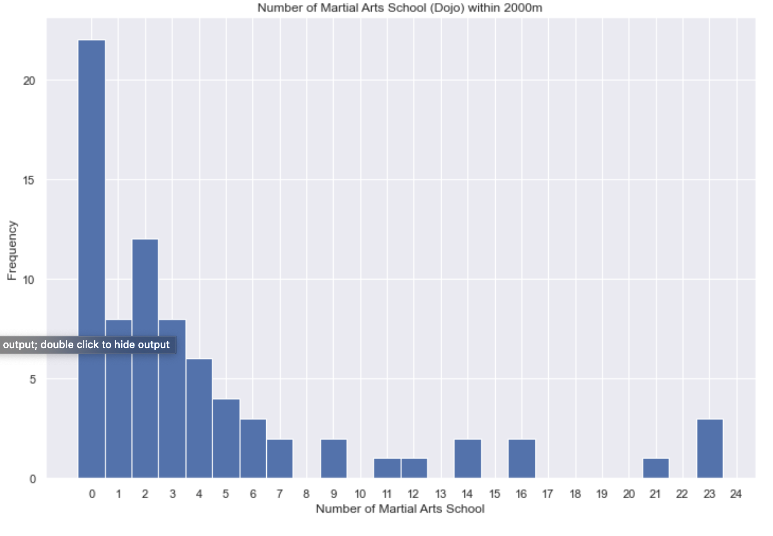
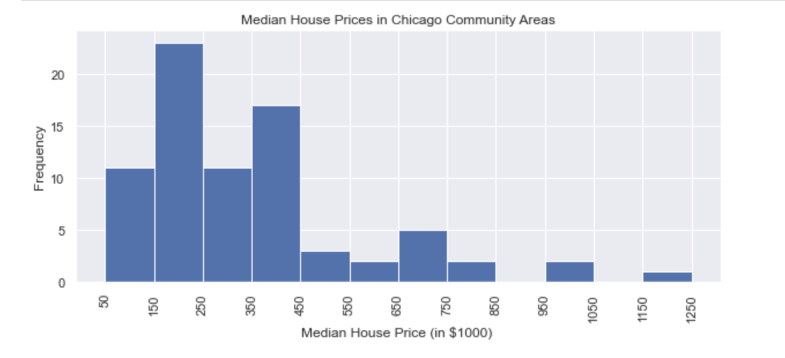
Most of these features have skewed distributions – quite natural

Slide 15
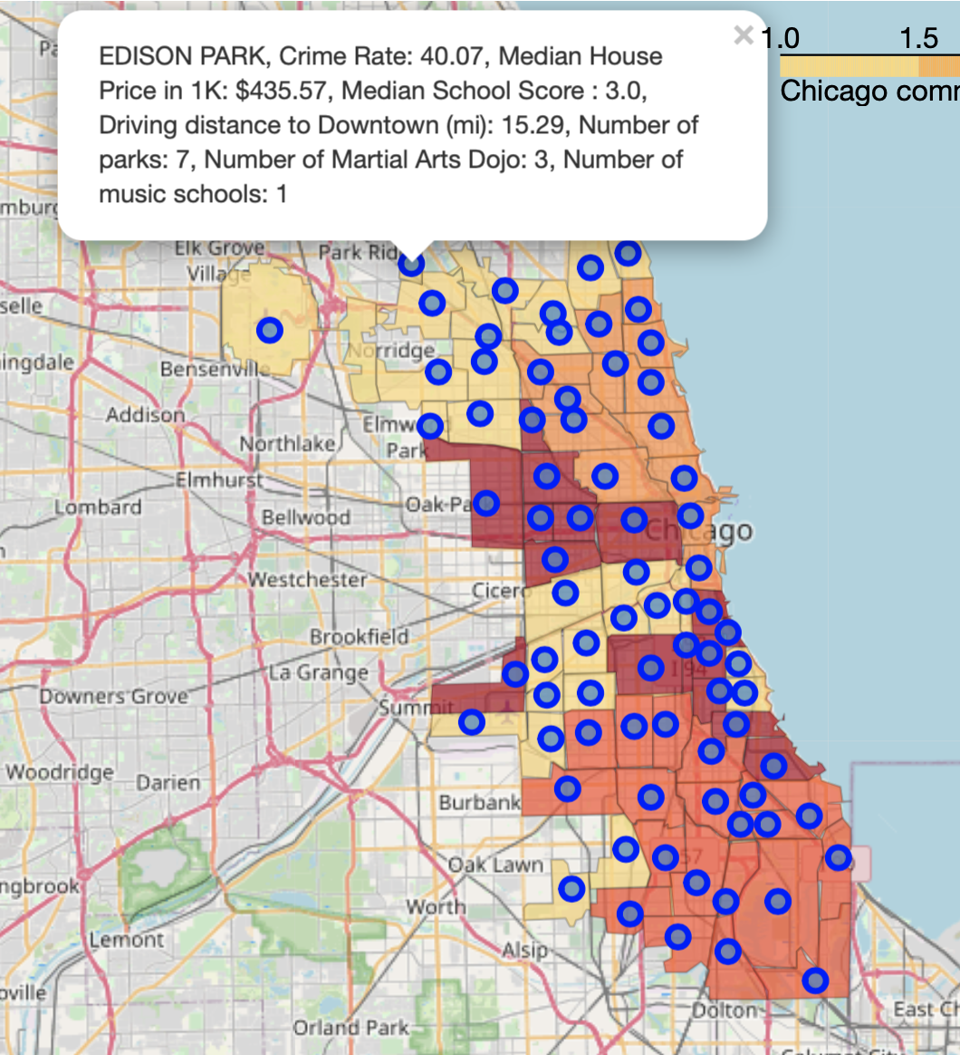
KMEANS clustering
- Skewed features: Take the logarithm to normalize
- Use standard scaler (obtain z scores)
- Consider importance of features:
Primary features: Crime rate, Median House Price Median School Score
Secondary features: Driving distance, number of venues of interest
1st level : use primary features in KMeans, obtain 2 clusters – use elbow method and silhouette scores to determine K=2
2nd level: Use secondary features in Kmeans for both of the primary clusters - use elbow method and silhouette scores to determine K=2
Obtained 4 clusters, each represented by a different color on the map.
Map also has markers for each community area listing feature values
The family can compare community areas using this map

Slide 16
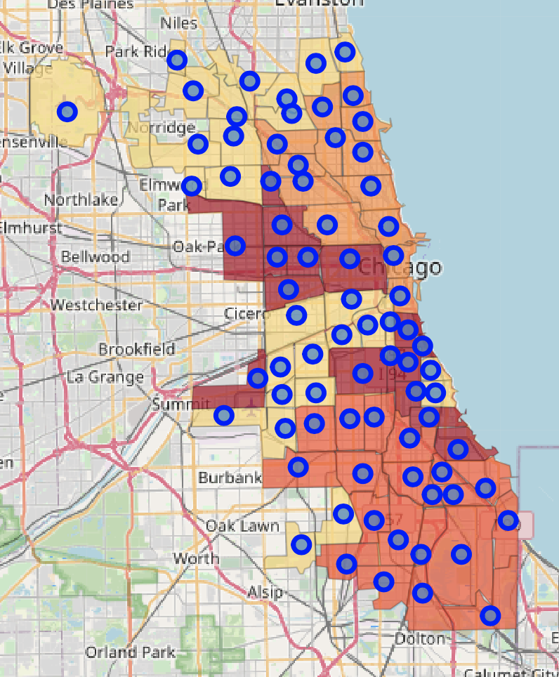
Yellow cluster (1):
lower crime rates (most are below 100 and all are below 145 per 1000 residents).
median house prices below $450000 - except Kenwood and Hyde Park , $640,000, at the shore
median school scores mostly at or above 4 – except Gage Park, Clearing (3.5)
number of music schools or martial arts dojos within 2km is 0 or 1- except Jefferson Park and Portage Park
Orange cluster (2):
lower crime rates. most below 120, the exceptions are the community areas very close to Downtown such as Loop (424.64) and Near North Side (214.99)
median house prices start at $400K and go as high as $1200K. The community areas in the north west region of this cluster, Irving Park and Avondale, have the lowest house prices in this cluster.
median school scores are all at or above 4 with only one exception of 3.5 (Near South Side)
parks, music schools, and martial arts dojos are abundant in these community areas.

Slide 17
Dark orange cluster (3):
northern part of this cluster -> pretty high crime rates
(Englewood: 425, Greater Grand Crossing: 378)
Lowest house prices –most under $150K
The median school scores are all at or below 3 – except Englewood and Eastside (3.5)
some parks, no music schools, very few have martial arts schools
Darkest cluster (4):
high crime rates- most above 200.
Hermosa and Garfield Ridge are the safest community areas in this cluster with crime rates below 100.
median house prices close to $200K and above going as high as $500K.
median school scores are 3 or below except for Humboldt Park (4) and West Garfield Park (3).
The community areas in this cluster at the top side have in general good number of parks, music schools and martial art dojos. The southern parts of the cluster lack those venue types except for the parks.

Slide 18
Results
the community areas in the Orange Cluster (2) are the best if the family can afford it.
Especially Irving Park and Avondale can be good choices as they have lower house prices.
The next best cluster is the Yellow Cluster (1). The family can especially consider the community areas in this cluster that are at the boundary of the Orange Cluster.

Slide 19
We can also filter the values in our data frame to come up with a short list. Let’s use the following criteria:
1. median house price is less than $700,000
2. crime rate less than 230 (per 1000 residents considering total number of crimes in since 2019)
3. median school score is greater than or equal to 4
4. more than 2 parks
5. at least one music school and one martial arts school
6. driving distance less than 11 miles
Jefferson Park is the best choice based on these criteria:
Community Area | Crime Rate | Median House Price | Median School Score | Driving Distance to Downtown (mi) | Number of Parks within 1km | Number of Martial Arts Schools within 2 km | Number of Music Schools within 2 km
Jefferson Park | 66.73 | $312,732.5 | 4.5 | 10.58 | 5 | 7 | 2
Irving Park | 81.75 | $427,607.0 | 4 | 8.38 | 4 | 9 | 3
Avondale | 99.76 | $486,231.0 | 4 | 7.19 | 15 | 12 | 6
West Town | 141.62 | $692,204.5 | 4 | 5.21 | 11 | 14 | 3

Slide 20
Conclusion
Collected most recent crime and median house price data
Collected data from several sources ( web scraping, use of APIs: Foursquare, Microsoft Bing Maps Distance Matrix API, SODA API) and combined at the community area level
Created choropleth maps and histograms for Explatory Data Analysis
Used Kmeans clustering to form clusters and interpreted them
Accounted for importance of features in clustering using a 2-step clustering approach focusing on primary and secondary features
Generated a map that the family/user can use to compare community areas
Suggestied clusters of community areas to look into (1-orange, 2-yellow at the orange boundary)
Short listed some community areas (Jefferson Park, Irving Park, Avondale, West Town)
Valuable results to any person who is considering to move to Chicago and people/stakeholders who would want to know more about Chicago community areas for other purposes including city/business planning.
Got many ideas for new projects (many data sets, APIs)

